Slide 1

Cloud TiDB
邓栓 | PingCAP

Slide 2
About me
邓栓(Tennix)
PingCAP cloud integration team

Slide 3
TiDB Architecture
PD
PD
TSO/Data location
Data location
PD
PD Cluster
Metadata
Spark Driver
TiDB
TiKV
TiKV
Job
Application
TiDB
DistSQL API
DistSQL API
TiDB
TiKV
TiKV
Worker
Syncer
Worker
TiDB
TiKV
TiKV
Worker
TiDB
...
...
...
Spark Cluster
TiDB Cluster
TiKV Cluster (Storage)
TiSpark

Slide 4





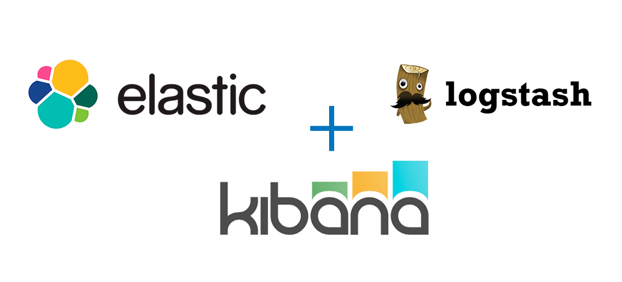

Complexity of Distributed System(TiDB)
Promethues
tispark
tidb-server
tikv-server
Grafana
pd-server
tidb-binlog

Slide 5
Traditional Deployment Tools
Puppet, Chef, SaltStack, Ansible
Complicated and dirty: shell + DSL
Mostly static deployment
Good for day-0(deployment) not for day-1(management)

Slide 6
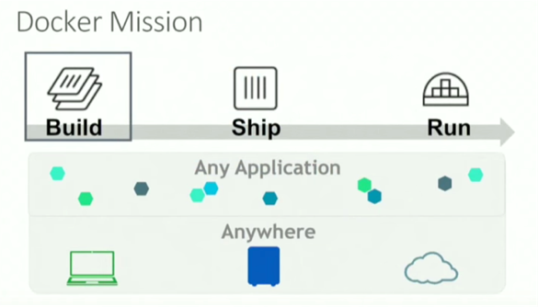
Docker & Kubernetes
Consistent env for dev and prod
Standardized distribution format
Isolation

Slide 7
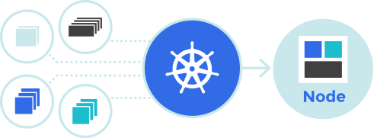
Docker & Kubernetes
Kubernetes based on Borg (Cloud OS)
Active community
Easy integration with Cloud

Slide 8
Docker & Kubernetes
PaaS: app mainifests => running apps
Extensible with rich API: TPR(deprecated), CRD, Operator, Cloud Provider, Network plugin, Scheduler Extender, AA...

Slide 9

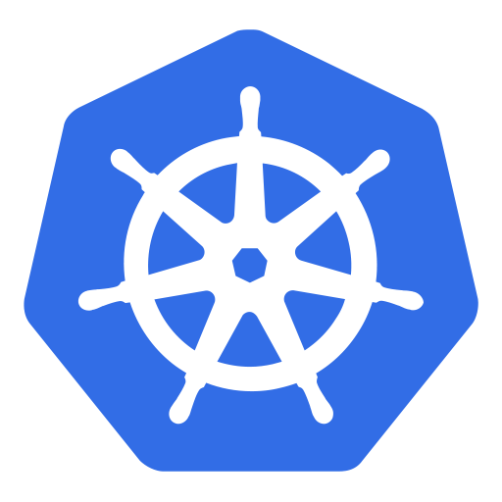
Docker & Kubernetes
yaml
apiserver
kubectl
Replication Controller
controller-manager
Service
etcd
Pod
scheduler
Pod
kubelet
kube-proxy

Slide 10
Problems with k8s
Stateful service(status management, io performance)
Local PV
Advanced scheduling strategy

Slide 11

Cloud TiDB Architecture
Cloud Console
TiDB Dashboard
TiDB Cloud Manager
TiDB Cloud
API Server
TiDB Instance Controller
Job Controller
TiDB Controller Manager
TiDB Scheduler:
TiDB Scheduler
TiDB Cluster Controller
Kube Scheduler
TiKV Controller
PD Controller
TiDB Controller
TiDB Volume Manager
Kubernetes Core
Scheduler
Controller Manager
API Server

Slide 12
TiDB-Operator
Domain specific ops knowledge
Local PV (IO performance)
Extended scheduling

Slide 13
TiDB-Operator
yaml
kube-apiserver
CM/SVC
tidb-controller-manager
tidbcluster-controller pd-controller
tikv-controller
tidb-controller
TidbCluster
TidbCluster
kube-controller-manager
TidbSet
etcd
Pod
PD/TiDB/TiKV
kube-scheduler
Pod
TiDB
tidb-scheduler
kube-scheduler
tidb-scheduler
Pod
PD/TiKV
PVC
Pod
PD/TiDB/TiKV
kubelet
PV
tidb-volume-manager
kube-proxy

Slide 14
TiDB-Operator
tidb-controller-manager
tidb-scheduler
tidb-volume-manager

Slide 15
tidb-controller-manager
CRD: TidbCluster, TidbSet
Controllers: * tidbcluster-controller * pd-controller * tikv-controller * tidb-controller * gc-controller
Two layer HA

Slide 16
tidb-scheduler
Builtin basic scheduling(cpu/memory/affinity)
scheduler extender(Local PV)
Two layer scheduling (LB & HA)

Slide 17
tidb-volume-manager
hostPath based Local PV
PV management
Volume metrics

Slide 18
TiDB-Cloud-Manager
API Server: RESTful interface
TiDB Instance Controller: TiDB Cluster + Non-Core Components(monitoring, spark, kafka…)
Connect TiDB/TiDB-Operator with Cloud
Expose TiDB service via Cloud LoadBalancer

Slide 19
Thanks!
Contact me:
dengshuan@pingcap.com www.pingcap.com Wechat: ztennix

